Slide 1
E-Commerce Data Analysis using Power BI

Slide 2
Project Overview
Analyze product performance
Customer churn & segmentation
Seller performance
Delivery delay analysis

Slide 3
Dataset Overview
Source: Kaggle
Tables: Orders, Customers, Products, Sellers, reviews
Key columns used: customer_id, customer_state, order_id, order_purchase_timestamp, order_delivered_customer_date, product_id, seller_id, price, freight_value, payment_type, review _score, product_category_name

Slide 4
Tools & Technologies
Power BI
Excel / Python
Data cleaning & transformation

Slide 5
Key KPIs
Total Revenue
Total Orders
Total Customers
Churn Rate
Avg Delivery Time
Avg Review Score

Slide 6
Product Analysis
Top Performing Product Categories The analysis identifies the following categories as the highest contributors in terms of sales volume:
cama_mesa_banho (11,847 units) – Bed, Bath & Table
beleza_saude (9,944 units) – Beauty & Health
esporte_lazer (8,942 units) – Sports & Leisure
moveis_decoracao (8,942 units) – Furniture & Decoration
informatica_acessorios (8,150 units) – IT / Computer Accessories
These categories represent the core demand drivers and play a significant role in overall business performance.
Least Performing Product Categories The following categories have minimal sales and limited impact on overall performance:
seguros_e_servicos (2 units) – Insurance & Services
portateis_cozinha_e_preparadores_de_alimentos (3 units) – Portable Kitchen & Food Preparers
artes_e_artesanato (6 units) – Arts & Crafts
Due to their low volume, these categories can be grouped under “Others” for more meaningful analysis.
Revenue Contribution The top 5 product categories contribute approximately 40% of the total revenue, amounting to nearly 6.44 million. This indicates a strong concentration of revenue within a limited number of categories.
Payment Behavior Insights Credit cards are the most preferred payment method among customers. This is largely driven by the availability of installment-based payments, with customers opting for an average of 3 installments per transaction.

Slide 7
Customer Churn Analysis
Churn Definition: Customers who have stopped purchasing or become inactive over a specific period.
Churn Rate: The percentage of customers who stopped doing business with the company during a given time period.
Churn Customers: Customers who left or became inactive
Non-Churn Customers: Active customers who continue to purchase
Key insights
Customer Purchase Frequency Out of a total of approximately 97,000 customers, nearly 91,000 customers have made only a single purchase. This indicates a very high proportion of one-time buyers, highlighting challenges in customer retention and repeat engagement.
Impact of Delivery Experience on Churn Customers who experience delayed deliveries are significantly more likely to churn. This reinforces the importance of timely order fulfillment in maintaining customer loyalty and reducing attrition.
Year-wise Churn Trends
In 2016 and 2017, the churn rate was extremely high at around 98%, indicating very low customer retention during the early years.
In 2018, the churn rate dropped significantly to approximately 27%, suggesting notable improvements in customer retention strategies and overall service performance.

Slide 8
Customer Segmentation
High Potential Customers: Purchased recently, only one purchase so far, high spend per order.
Action: Onboarding emails, First repeat purchase discounts, Product recommendations
Low Value Customers: Purchased relatively recently, single purchase, very low spend (use low cost marketing, do not overspend on retention.
Action: Low-cost marketing, Do not overspend on retention
High Value: Buy more than once on an average, high spending (loyal customers, repeat buyers).
Action: Exclusive discounts or cashback, reward points/membership tiers (Gold, Silver, Platinum).
At Risk: Long time since last purchase, bought only once, medium-low spending (inactive customers)
Action: Re-engagement campaigns, Win-back offers, Reminder emails

Slide 9
Seller Performance
Top sellers:
4a3ca9315b744ce9f8e9374361493884(2128), 6560211a19b47992c3666cc44a7e94c0(2111), 1f50f920176fa81dab994f9023523100(2009)
Rating vs sales:
Average Seller rating is 4.08

Slide 10
Delivery Delay Analysis
Average Delivery Time The overall average delivery time is approximately 12 days, indicating the typical duration required for orders to reach customers.
On-Time vs Delayed Deliveries Approximately 8% of total deliveries are delayed, while the majority of orders are delivered within the expected timeframe.
Impact on Customer Reviews Delivery timeliness has a significant influence on customer satisfaction:
Late deliveries have an average review rating of 2.3
On-time deliveries achieve a much higher average rating of 4.1
This highlights a strong negative impact of delays on customer perception.
Key Insights
Processing Delay as a Primary Driver Orders with delayed delivery experience a higher average processing time (~6.5 days) compared to on-time deliveries (~3.8 days), indicating that internal processing inefficiencies are a major contributor to delays.
Customer Satisfaction Impact Delivery delays significantly reduce product review scores, emphasizing the importance of timely fulfillment in maintaining positive customer experiences.
Churn Correlation Customers who experience delayed deliveries are more likely to churn.
Churned customers: average delivery time of ~13 days
Non-churned customers: average delivery time of ~10 days
This suggests that prolonged delivery times are strongly associated with customer attrition.
Conclusion Improving processing efficiency and reducing delivery delays can significantly enhance customer satisfaction, improve review scores, and reduce churn rates.

Slide 11
Dashboard Overview

Slide 12
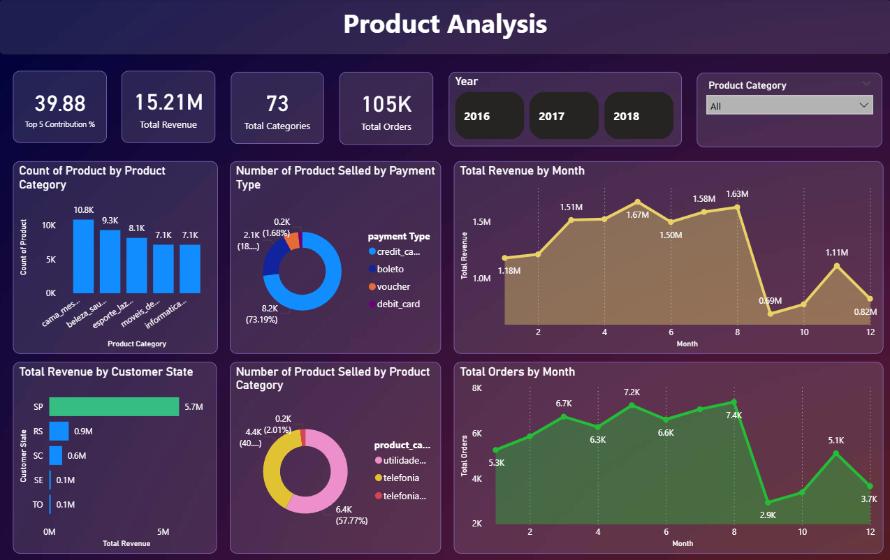

Slide 13
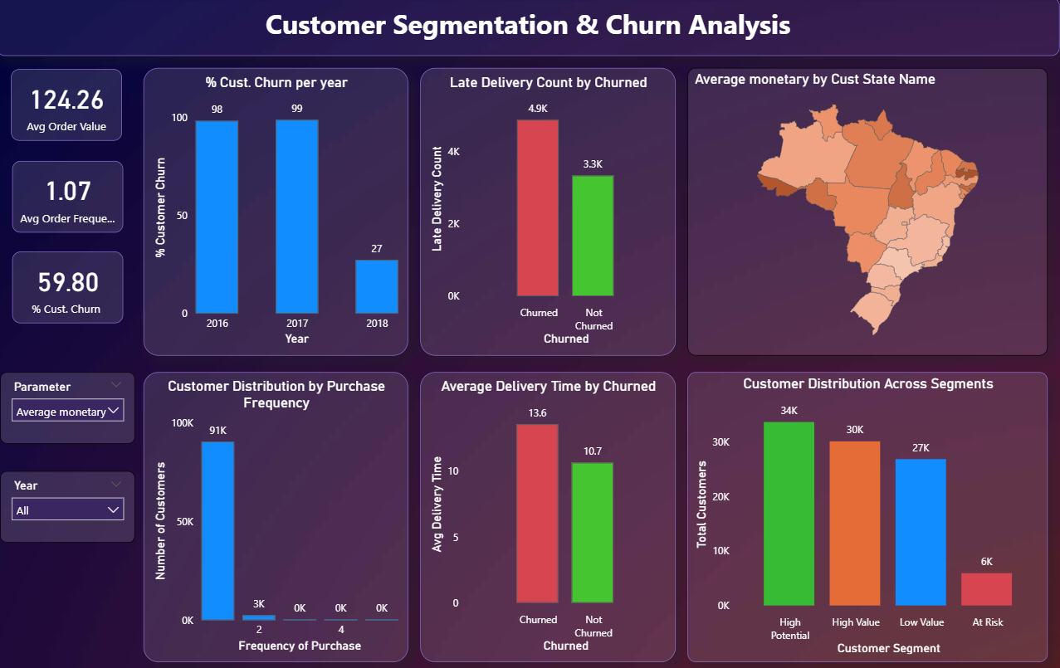

Slide 14
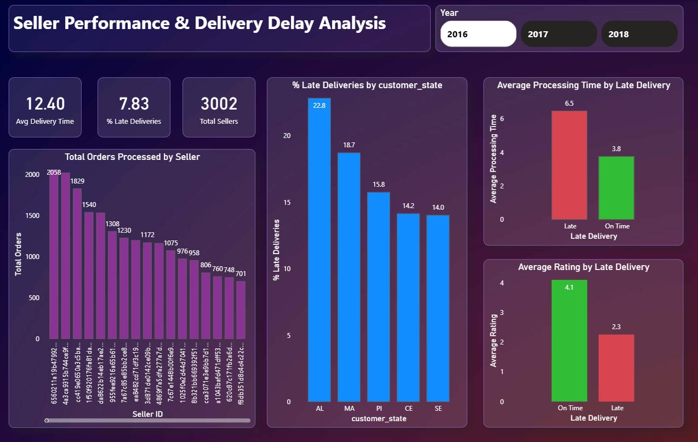

Slide 15
Thank You

